Slide 1

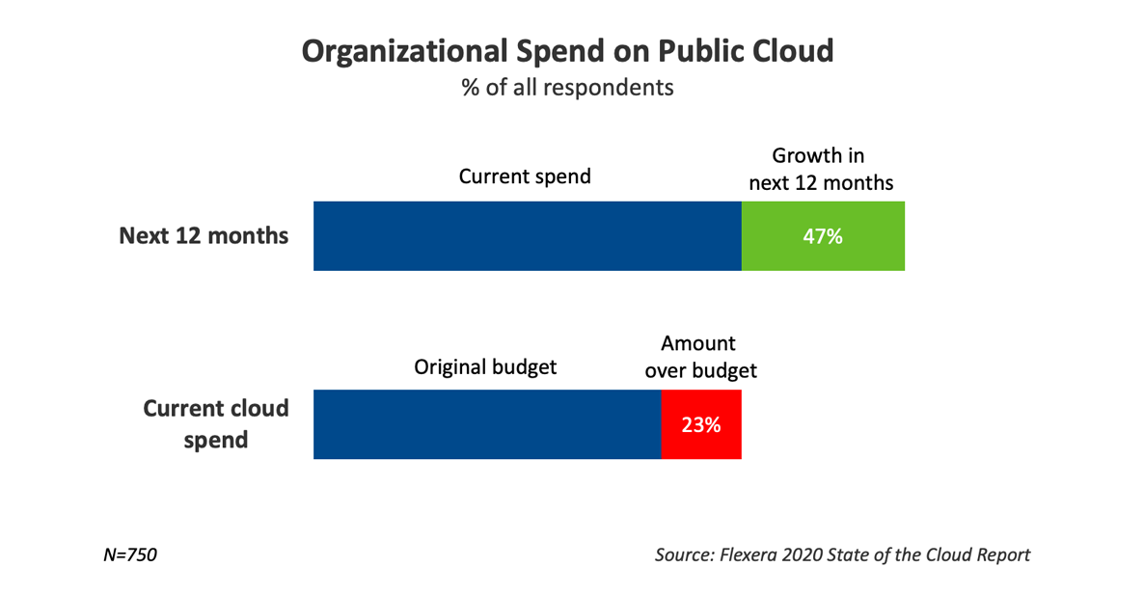
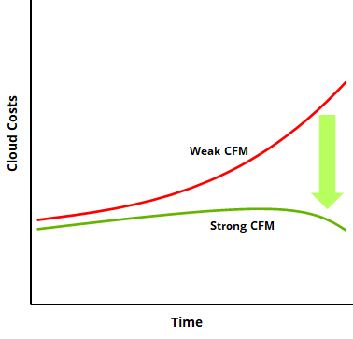
Cloud Financial Management
Effectively navigate cloud’s financial and operational challenges
Cloud introduces new complexity into IT financial management that often can’t be successfully navigated with traditional processes. To provide spending transparency, keep costs in check, and gain the expected ROI on their cloud investments, organizations need a new cloud financial management operating model. Deloitte’s Cloud Financial Management (CFM) services can help.
Total cloud spend expected to be wasted as of March 2021¹
Why do businesses need CFM?
30%
Variable Spend at High Velocity
On demand consumption and pricing models drive a requirement to react to changes in spend pattens in real time improve workflow
Operating Model Changes
IT and Finance organizations will need to operate more efficiently together in order to support the agility of the business and pro-actively monitor and react to spend
Average overspend was reported by companies in 2020¹
24%
Data & Pricing Complexity
The complexity of cloud provider service and pricing structures drives a necessity for enhanced mapping of organizational data to cloud provider bills
Ability to Predict Demand
Understanding future demand will drive what type of commercial option(s) are selected from service providers; use of on-demand vs subscription options is critical to gain cost efficiency
Organizations have cloud spend optimization as their top cloud initiative¹
Outcomes & Impact
61%
Cloud opportunity and business case defined and communicated effectively to leadership
Cloud FinOps capability defined and stood up to financially govern Cloud spend
Expected average increase in spend budget in 2021 - 2022¹
Optimized Cloud cost that maximizes savings and return on investment
Full integration of financial management embedded in the operating model and culture
39%
CONTACT US: Rakinder Sembhi|rsembhi@deloitte.com | Akash Tayal|aktayal@deloitte.com | Dan Grayson|dangrayson@deloitte.com | Mark Steckel|msteckel@deloitte.com
Sources: (1) Cloud Computing Trends: 2021 State of the Cloud Report’; Flexera

Slide 2
Cloud Financial Management Capabilities
Deloitte’s Cloud Financial Management capabilities will support you throughout every stage of your cloud journey to develop best in class tools, processes and structures that will enable the financial transparency, predictability, and controls needed to maximize the value of the cloud.
Move
Transform
Inform
Optimize
Plan
Run
Drive business case to evaluate the costs associated with moving to and operating in the Cloud
Transform your organization, operating model, and processes to manage cloud spend while balancing agility and control
Articulate Cloud spend and align organization through data structures and reporting which enable accountability and real-time decision
Establish the tools and processes to continuously optimize cloud spend by driving consumption efficiency and making effective purchasing decisions
Build the capabilities to accurately predict supply and demand for cloud services
Develop a holistic and integrated approach to inform, optimize and operate cloud financial management.
Outcomes & Impact
Business case for cloud
Optimized Cloud costs
Cloud FinOps capability
CFM fully integrated and embedded
Advise
Implement
Operate
CONTACT US: Rakinder Sembhi|rsembhi@deloitte.com | Akash Tayal|aktayal@deloitte.com | Dan Grayson|dangrayson@deloitte.com | Mark Steckel|msteckel@deloitte.com

Slide 3
Deloitte tools, accelerators, and FinOps-as-a-Service—for rapid and lasting success
To help our clients build a business case for cloud—both present and long-term—we employ a suite of tools and accelerators like the Deloitte Cloud Value Calculator and the Deloitte Cloud Financial Analysis Tool. To enable long-term success, we offer FinOps-as-a-Service (FOaaS) to help clients optimize cloud spend, govern spend more effectively, and operate efficiently over time.
Deloitte tools and accelerators
FinOps-as-a-Service
Cloud Financial Analysis Tool
Analyzes overall TCO and P&L impacts as clients begin planning for their cloud journey
Finance Cloud Business Case Model
Determine financial benefits from moving to a cloud solution and highlight various processes and factors for consideration
Cloud TCO Calculator
SaaS-based tool that provides a comprehensive and repeatable Cloud TCO, P&L and cost-save levers analysis
To keep our clients’ cloud journey on track, we offer FOaaS, an ongoing package of services for Cloud Financial Management, that helps them continue to inform, optimize, and effectively operate their cloud financial model. FOaaS helps inform decisions and optimize operations. It also helps our clients operate cost-effectively long-term.
Inform
Optimize
Operate
Spend Transparency
Tagging
Showback and Chargeback
Internal and External Benchmarking
Waste & Consumption Management
Alerting & Monitoring
Purchasing Best Practices
Automation
Cost Aware Architecture
Forecasting
Agile Budgeting
Metrics-Driven Cost Optimization
Unit Economics Based Management
Incremental Automation
Workflow and operating model improvements
Cloud Pricing Engine
Identifies and evaluates pricing options within vendor pricing SKUs and between vendors
CFM Maturity Tool
A diagnostic tool for evaluating an organization's level of maturity for financial management in the cloud and identifying opportunities for optimization and improvement
Why Deloitte Cloud?
All that cloud can do is amplified by all that Deloitte can do. Our integrated cloud offerings fuse Deloitte’s trusted business acumen with extensive tech services that together work to modernize and transform how our clients operate. Learn more about how Deloitte can help you on your cloud journey. www.deloitte.com/us/cloud
Let’s talk
Rakinder Sembhi
Principal
Deloitte Consulting LLP
rsembhi@deloitte.com
Akash Tayal
Principal
Deloitte Consulting LLP
aktayal@deloitte.com
Dan Grayson
Principal
Deloitte Consulting LLP
dangrayson@deloitte.com
Mark Steckel
Specialist Leader
Deloitte Consulting LLP
msteckel@deloitte.com
DTTL: © 2021. For information, contact Deloitte Touche Tohmatsu Limited. All content protected under nondisclosure and may not be used or reproduced without express permission of Deloitte.

